Slide 1
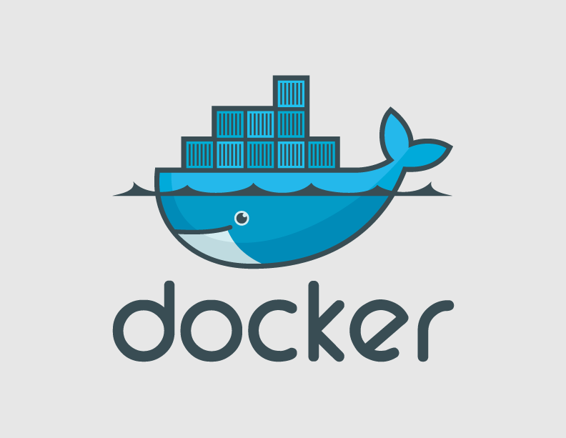
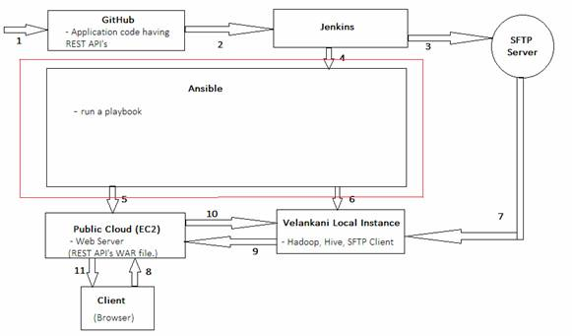
Sandbox Work flow Overview

Slide 2
Software Build Management
Software build, packaging, and deployment play a crucial role in release management.
Jenkins can efficiently orchestrate complex workflows required by large teams. By integrating with the source code control system, Jenkins can invoke multiple build processes targeting different environments. The output of this would result in a set of EXEs, DLLs, or JAR files depending on the platform

Slide 3
Intro of Docker
An open-source project for automating the deployment of applications as portable, self-sufficient containers that can run virtually anywhere on any type of server.
Docker serves as a lightweight alternative to full machine virtualization provided by traditional hypervisors like VMware's ESXi, Xen or KVM.
With a traditional hypervisor approach, each virtual machine (VM) needs its own operating system, but with Docker, applications operate inside a container that resides on a single host operating system that can serve many different containers.
Docker containers are designed to run on everything from physical computers to virtual machines, OpenStack cloud clusters, public instances and more.

Slide 4
Cont..
Instead of deploying the final set of artifacts such as EXE and JAR files to the target environment, ops teams are now packaging the entire application as a Docker Image.
This image shares the same build version before getting published to a central registry. It is then picked up by various environments – development, testing, staging, and production – for final deployment
The lethal combination of Jenkins and Docker is proving to be very valuable for DevOps teams. By leveraging the tight integration with source code control mechanisms such as Git, Jenkins can initiate a build process each time a developer commits his code. This process results in a new Docker image which is instantly available across environments. Organizations are deploying private Docker registries to publish and maintain their internal Docker images.

Slide 5
Why Developers use Docker
Build once and run anywhere
A clean, safe, hygienic, portable runtime environment for your app.
No worries about missing dependencies, packages and other pain points during subsequent deployments.
Run each app in its own isolated container, so we can run various versions of libraries and other dependencies for each app without worrying.
Automate testing, integration, packaging anything we can script.
Reduce/eliminate concerns about compatibility on different platforms, either we own or our customers.

Slide 6
Why Administrators Care
Configure once... run anything
Make the entire lifecycle more efficient, consistent, and repeatable
Increase the quality of code produced by developers.
Eliminate inconsistencies between development, test, production, and customer environments.
Significantly improves the speed and reliability of continuous deployment and continuous integration systems.
Because the containers are so lightweight, address significant performance, costs, deployment, and portability issues normally associated with VMs.

Slide 7
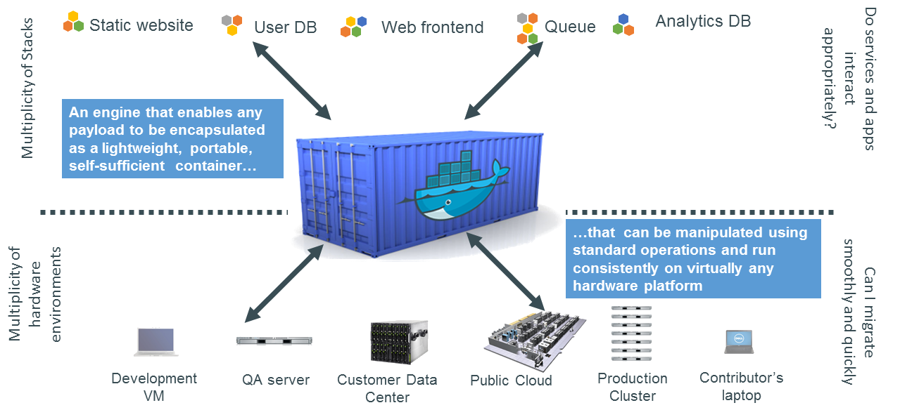

Slide 8
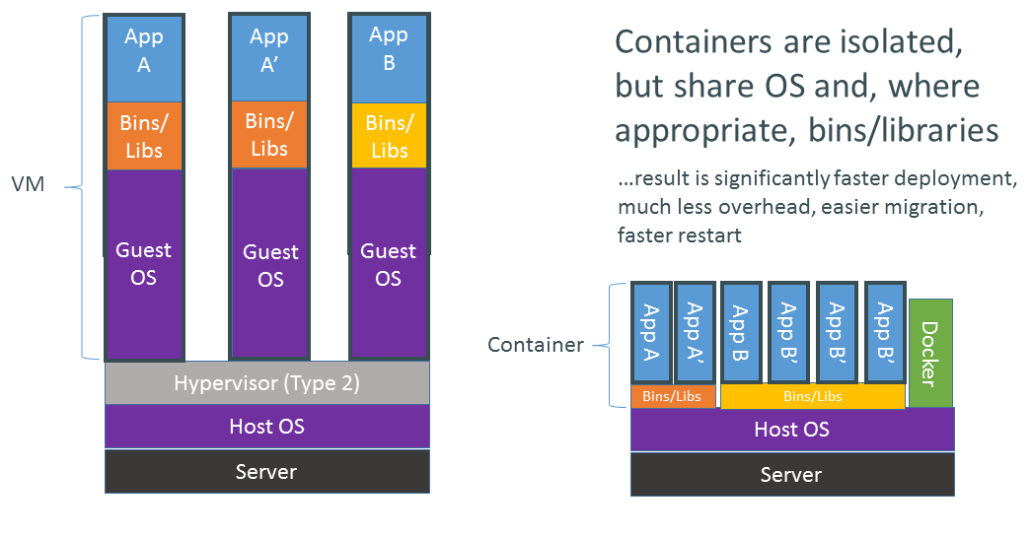
VMs vs Containers

Slide 9
High level approach:Lightweight VM
own process space
own network interface
can run stuff as root
can have its own /sbin/init
share kernel with host

Slide 10
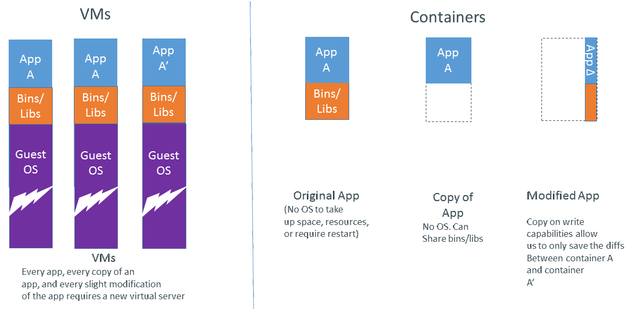
Why are Docker Containers Lightweight

Slide 11
Deploy almost everywhere
Linux servers
VMs
Kernel 3.8 (or RHEL 2.6.32)

Slide 12
Deploy reliably, efficiently & consistently
If it works locally, it will work on the server
With exactly the same behaviour
Regardless of versions
Regardless of dependencies
Containers are lightweight
Typical laptop runs 10-100 containers easily
Typical server can run 100-1000 containers

Slide 13
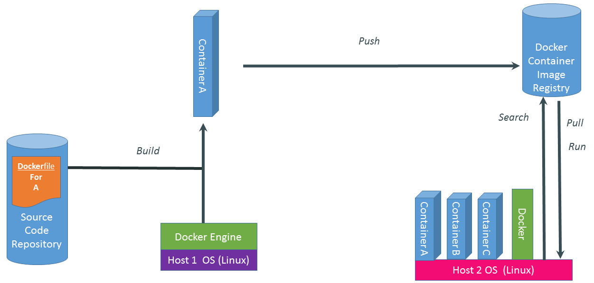
Docker System

Slide 14
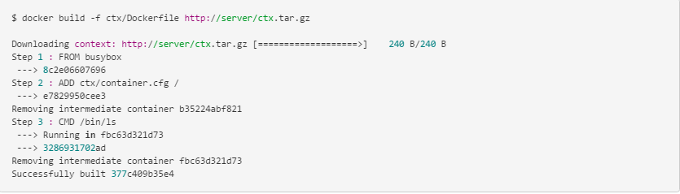
Docker build

Slide 15
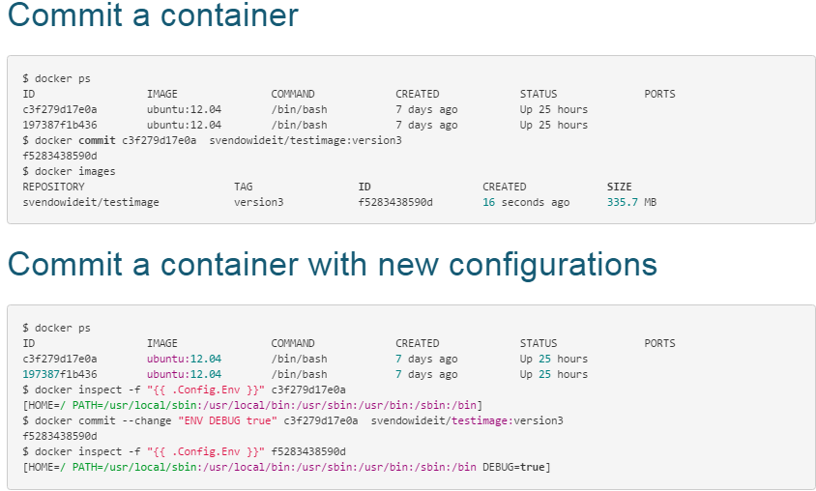

Slide 16
Thank You
www.velankani.com
NOV 2014

